Slide 1
CAPSTONE PROJECT
House Price Prediction with Deep Learning
Final Project
Presented By
GUNASEKARAN V
711721244020
III BTech CSBS
KGISL Institute of Technology
1

Slide 2
PROJECT TITLE
For those who are buying or selling a property, as well as for real estate agents ,projecting house prices with precision is crucial. The use of deep learning techniques to create reliable, data-centric models for accurate house price prediction will be covered in this talk.
3/21/2024 AnnualReview
2

Slide 3


AGENDA
1.Problem Statement 2.Project Overview 3.End Users
4.Solution and Value Proposition 5.The Wow Factor in Your Solution
6.Modelling 7.Results

Slide 4


PROBLEM STATEMENT
.
Problem: Traditional methods often fail to capture the intricate patterns and nonlinear relationships found in housing data.
Obstacle: Reaching accurate estimations of home values requires negotiating a plethora of variables, such as area, number of bedrooms, and more.
Objective: Build a deep learning model that can accurately predict home values by combining various features

Slide 5

PROJECT OVERVIEW
Goal: Construct a deep learning model that can combain a variety of traits and market data to accurately predict home prices.
Methodology: Compile and prepare large housing database, design a neural network architecture, and train and optimize the model
Desired Results: A flexible and robust home price forecasting model that outperforms traditional methods, produces improved results, and provides useful information.

Slide 6
WHO ARE THE END USERS?
Potential Buyers: Acquire accurate estimates to enable informed decisions during the buying process
Home Vendors: In a competitive market, choose the best pricing tactics to maximize profits and improve the desirability of your property.
Housing professionals: Apply the model to raise the bar for consulting services and provide customers with better advices.

Slide 7

SOLUTION AND ITS VALUE PROPOSITION
Prospective Homebuyers: Acquires accurate estimates to enable informed decisions during the buying process.
Home Sellers: In a competitive market, choose the best pricing tactics to maximize profits and improved the desirability of your property.
cholarly Investigators: Analyze in-depth the dynamics of the housing market and the different factors influencing price changes.

Slide 8

THE WOW IN YOUR SOLUTION
Innovative AI technology: Our product makes use of the most recent developments in deep learning techniques to guarantee forecast with unmatched accuracy.
User-friendly design: Our platform’s user friendly interface makes it easy for user of all skills levels to utilize its powerful price predictions features.
Progressive Enhancement: The model is constantly imporved ,dynamically adjusting to changing market conditions and prevailing patterns.

Slide 9
MODELLING
Input parameters: Aspects such as the characteristics of the property, its location, market research and economic data.
Neural Network structure: Using batch normalization , dropout layers and other advanced techniques to improve a multilayer perceptron.
Training Dataset :An extensive collection of historical housing data obtained from many sources to guarantee all-encompassing coverage.

Slide 10
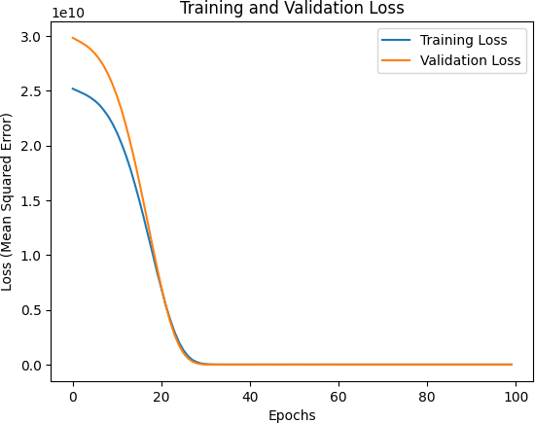
RESULTS
https://drive.google.com/drive/home

